Slide 1

Snapchat IPO

Slide 2
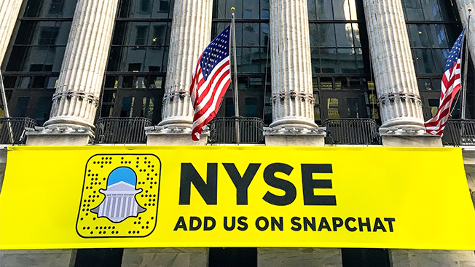
Valuing Snap
On March 2, 2017, Snap Inc. went public for $17.00 per share on the New York Stock Exchange (NYSE). At the end of the day, prices surged to close at $24.48. At that price, the firm had a market capitalization of $34 billion and its two founders (Bobby Murphy and Evan Spiegel) became the youngest billionaires in the country to own a public company. Over the next weeks, Snap traded as low as $19 and as high as $27. During this time, 14 analysts made investment recommendations on Snap: two with buy, six with holds, and six with sells.
The underwriters of Snaps initial public offering included Morgan Stanley and Goldman Sachs. They were forbidden from issuing reports on Snap until 25 days after the IPO, according to SEC rules. When the IPO quiet period ended on Monday, March 27th, 16 more firms issued reports (10 buy, 6 holds) with price targets ranging from $21 to $31. Brian Nowak, Morgan Stanley’s internet analyst, had priced it at $28 with an “overweight” recommendation.
Elizabeth Kemp was a portfolio manager of a $400 million technology fund (Sand Hill Road Capital) and had bought 500,000 Snap shares at the IPO. She gained $3 million ($22.74-$17.00)*500,000 shares. Should she buy more?
Internet analysts were pricing SNAP at a target of $18.00 and an underweight (sell) recommendation based on concerns about Snap’s unproven business model and growing competition from Facebook, Instagram, and Twitter. Should she buy more shares or sell?

Slide 3

Snap Background
Evan Spiegel met Bobby Murphy and Reggie Brown at Stanford University. They created the disappearing picture app in 2011 called Picaboo with Spiegel serving as CEO. Murphy was the chief technology officer and Brown was the chief marketing officer. Brown left the company and the founders changed the name to Snapchat. The app enabled users to send self-deleting images to other users. They then expanded to videos and could retain postings using the “my story” feature.
In 2016, the founders changed its name to Snap Inc. because they believed they were bigger than just one app. The firm’s advertising revenue is measured by the number of daily average users (DAU) times the average revenue per user (ARPU). At the end of 2016, it had advertising revenue of $378 million based on 158 million DAU’s and an annual ARPU of $2.39. Morgan Stanley’s Nowak predicted Snap would have revenue of $4.9 billion by 2020, based on 236 million DAU’s and an ARPU of $20.72.
In 2016, Snap generated $405 million in revenues but still lost $515 million in net income. The good news? It grew revenues by almost 600%. The bad news? It increased its losses by only 38%.
Since DAU was increasing, Snap raised $1.8 billion of equity from a group of venture capitalist firms. Having raised $2.6 billion in one year, Snap’s balance sheet became entirely debt free. However, the finance team lined up a $1.1 billion unsecured revolving credit line (July 2016) with a syndicate of lenders. This included Morgan Stanley, Goldman Sachs, Deutsche Bank, and Credit Suisse. The firm had 3 classes of common stock. Two had voting rights (Classes B and C) and one did not (Class A).

Slide 4
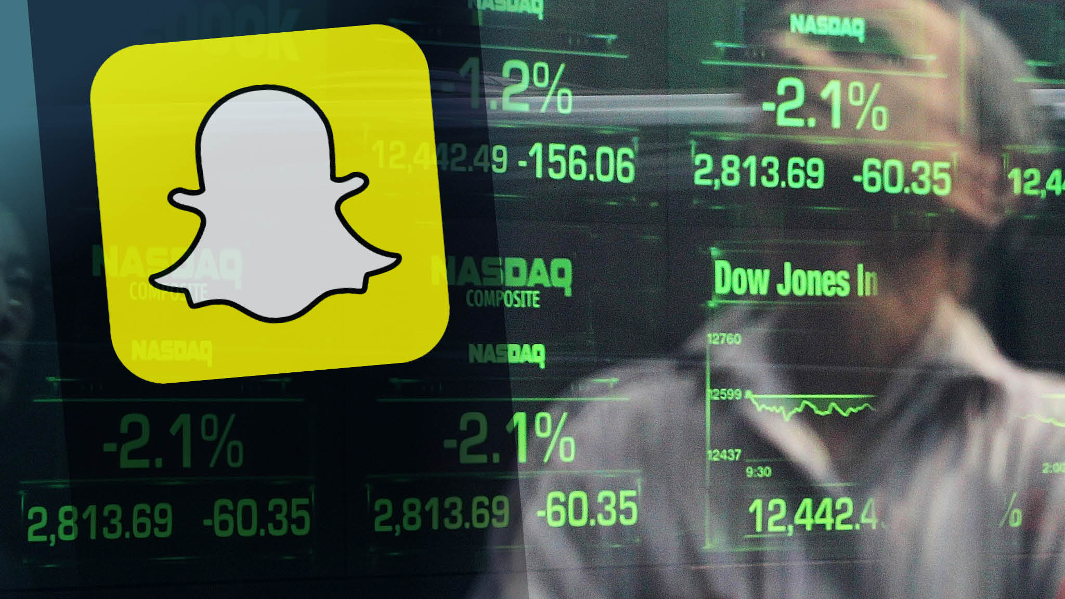
The IPO
In October 2016, Snap chose Morgan Stanley and Goldman Sachs to be the lead underwriters. Underwriters conduct due diligence on the firm and its financial condition. It helped write and file documents needed to issue equity. It created a syndicate of other brokerage firms to distribute shares. It contacted prospective investors to gauge interest in the offering. It helps determine the offer price.
Following the IPO, the underwriters bought shares to stabilize the price and provided research coverage for clients. Snap underwriters (a collection of 26 brokerage firms) would get a fee of 2.5% of the amount raised.
Reason for offering: To enhance Snap’s financial flexibility and increase capitalization.
In February 2017, Snap announced it would sell 145 million new Class A non-voting common shares and existing shareholders would sell another 55 million Class A shares. Spiegel and Murphy planned to sell 16 million Class A shares; however, they would still control 89% of the voting rights. They owned the majority of the Class B and C shares.
In total, there would be 1.4 billion shares outstanding after the offering. This was the first IPO on a US exchange of a stock with no voting rights. It is now more common to issue shares with limited voting rights.

Slide 5
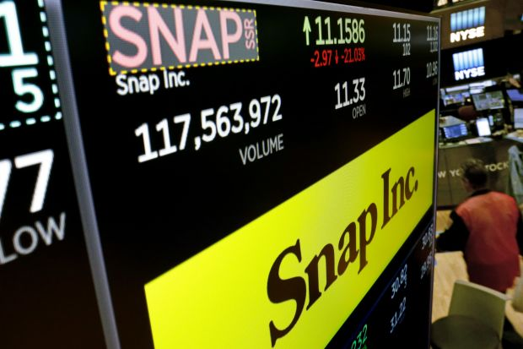
The IPO (cont.)
Four concerns with the Offering:
  No voting rights
  Price seemed too high. Facebook, Twitter, Alphabet, and Yelp traded at 4.5 times 2018 revenues. Snap would trade at 13.9 times expected 2018 revenues.
  Strong competitors vying for same advertising dollars
  Snap relied on powerful suppliers. It had recently signed long-term contracts worth $3 billion with Google Cloud and Amazon Web Services to provide computing, storage, bandwidth, and other services.
Despite these concerns, Snap closed up 44% at $24.48 on the first day of trading. The offering was oversubscribed by 10 times. The underwriters exercised their greenshoe or over-allotment option. This gave them the ability to sell an additional 30 million Class A shares at the offering price and collect additional underwriting fees.

Slide 6
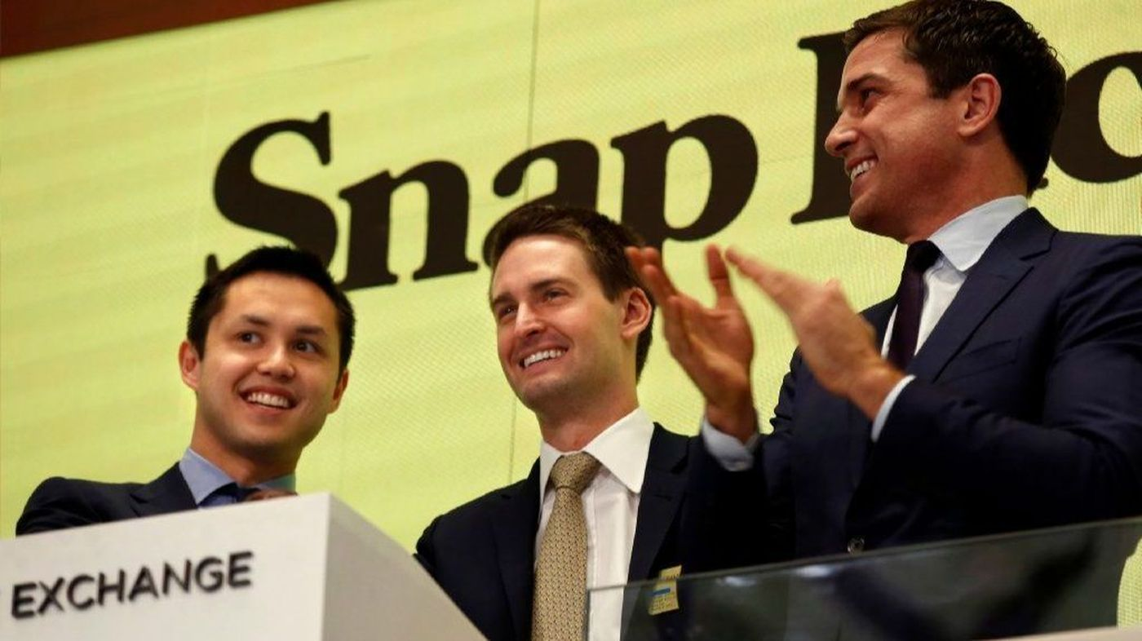
The Analyst Quiet Period
Investment bankers at Morgan Stanley had been underwriters for the Snap IPO. Analysts, like Nowak, had to issue a disclosure statement on his analysis disclosing this. In 2003, the SEC mandated that investment banking (corporate advisory and capital raising) should be separated from equity research (both physically and operationally) to ensure analyst compensation was not tied to banking fees. It also was intended to prevent the exchange of non-public information and to ensure stock recommendations were not “tainted” by efforts to obtain investment banking fees.

Slide 7

What Would You Do?
Snap seems poised for further price appreciation. Would you harvest gains or buy more shares? Kemp bought GoPro’s IPO in 2014 at $24 and it closed up 30% the first day. After the quiet period expired, she sold all her shares and then the price increased to $80 within three months.
Warren Buffett quote: What we learn from history is that people don’t learn from history. When investors get too fearful or too greedy, they sometimes hide behind the notion that ‘this time is different.’ Usually they regret it.

